Slide 1
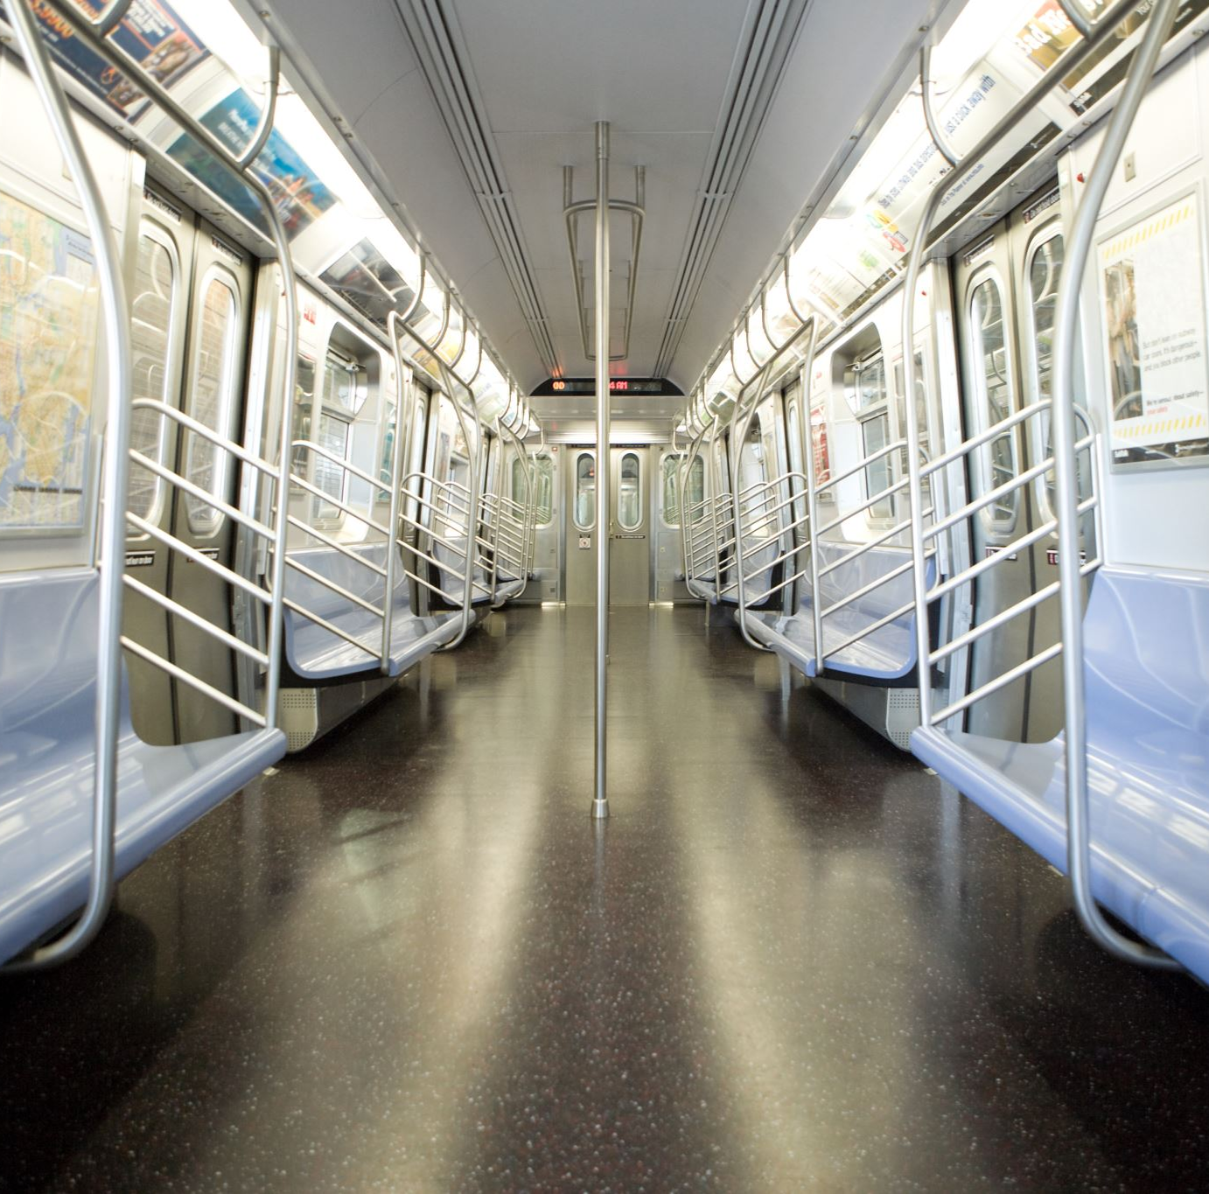


STM MetroMind: Forecasting Metro Incidents
By Layla Beylouneh, Kunal Das, Neha Sanjay Deshmukh & Marie Sophie Roy

Slide 2
The problem
Metro interruptions disrupt daily commutes.
affect employee punctuality and productivity
impact business and economic performance
Notes:
Metro delays and inefficiencies disrupt daily commutes.
Unpredictable transit affects employee punctuality and productivity.
Operational issues can impact business and economic performance.

Slide 3
Why it matters?
Reliable public transit is essential for a well-functioning city.
Metro Users
Optimize travel planning by making informed decisions
Minimize stress
STM (Montreal Transport Society)
Deploy extra staff during high-risk disruption period
Improve response time to incidents, reducing downtime

Slide 4
Why it matters?
Reliable public transit is essential for a well-functioning city.
Metro Users
Optimize travel planning by making informed decisions
Minimize stress
STM (Montreal Transport Society)
Deploy extra staff during high-risk disruption period
Improve response time to incidents, reducing downtime
Notes:
Regular metro users would be able to take precautions like leaving early or taking an alternative route,

Slide 5
Why it matters?
Reliable public transit is essential for a well-functioning city.
Metro Users
Optimize travel planning by making informed decisions
Minimize stress
STM (Montreal Transport Society)
Deploy extra staff during high-risk disruption period
Improve response time to incidents, reducing downtime
Environment
More reliable metro → Minimize frustration + Increase trust in public transport → More metro users → Metro = eco-friendly!
Notes:
we can allow metro users and the management of the Metro to predict possible crash outs, forecast peak incident hours, etc.

Slide 6
Why it matters?
Reliable public transit is essential for a well-functioning city.
Environment
More reliable metro → Minimize frustration + Increase trust in public transport → More metro users → Metro = eco-friendly!
Metro Users
Optimize travel planning by making informed decisions
Minimize stress
STM (Montreal Transport Society)
Deploy extra staff during high-risk disruption period
Improve response time to incidents, reducing downtime
Notes:
By improving service reliability
Enhance metro reliability → Reduce frustration and waiting times → Increase public trust in public transit→ Encourage more riders → Contribute to environmental sustainability through eco-friendly transit!

Slide 7
Our solution: STM MetroPredict
A metro incidents dashboard:
- Visualizations to highlight trends
- Data summarization to perform data analysis
A predictive analytics tool:
- Probability of metro disruption for a specific date, hour and metro line
Notes:
We tried to improve the simple dashboard by adding a predictive analytics model to forecast peak disruption hours in a given day.

Slide 8


How we built it
Data: City of Montreal's Open Data - Incidents on the metro network
Backend: Python
Frontend: Streamlit
→MLP (Multi-Layer Perceptron) = type of artificial neural network
Notes:
The MLP (Multi-Layer Perceptron) is a type of artificial neural network consisting of multiple layers of interconnected neurons, including an input layer (basically our data set/csv file of metro incidents), and an output layer (the predictive analysis), which allows it to learn complex patterns in data by processing information through these layers, making it suitable for our task: offering pertinent predictions to make metro’s users’ lives easier.

Slide 9

Use Chat GPT 4.0
Set up the local environment
Learn how to implement MLP into our dashboard
To test and debug the code
Convert R language in Python

Slide 10
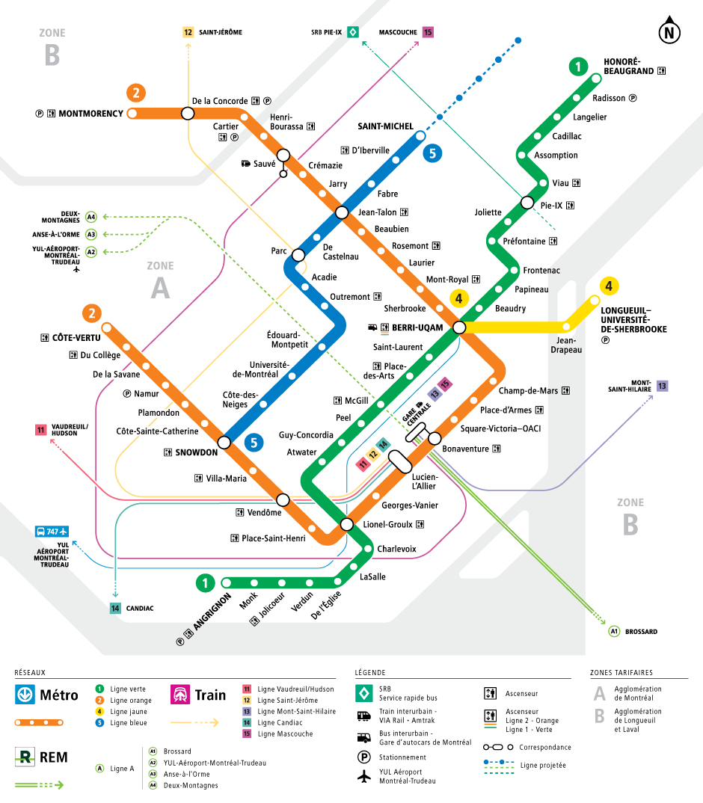
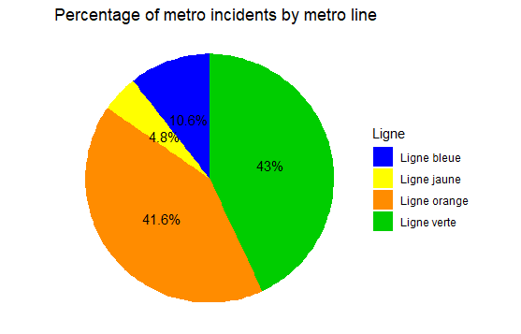
Highlighted trends
www.stm.info
The green and orange lines account for approximately 85% of all metro disruption incidents.

Slide 11
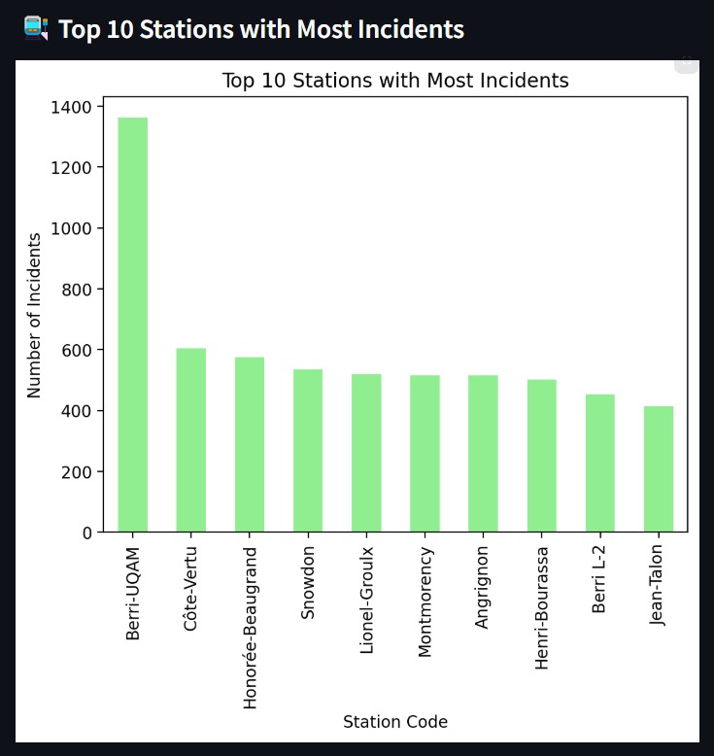
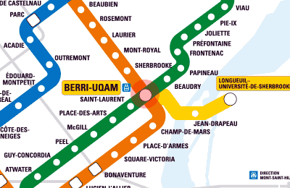
Highlighted trends
Most incidents in Berry-UQAM

Slide 12
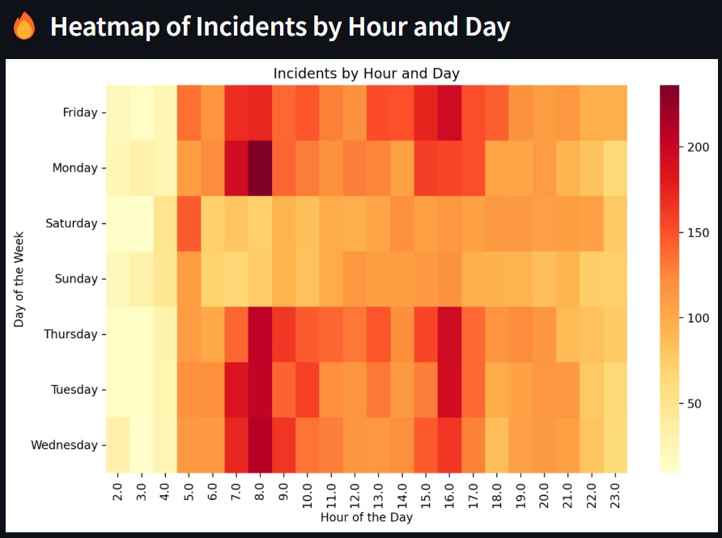
Highlighted trends
More interruptions during peak hours (7-9h and 15-17h)
Less interruptions during weekends

Slide 13
Take home message
Our project aims to solve a common real-life problem, which is unpredictable metro incidents.
Model is very simple, but expandable.
Furthermore, it aligns with DRW’s data-driven culture (by leveraging real-time analytics and predictive models).

